Slide 1
“For Lawyers”

Slide 2
(Logo)
About Library For Lawyers List
Get a Lawyer
(For Lawyers)
Offer your services
Join Now
For Free*

Slide 3
(Logo)
About Library For Lawyers List
Get a Lawyer
(This is when you scroll down)
Connect straight to clients
Get a free profile
accessible to all
Get your own lawfeed
where you can view and
answer* cases within your
expertise
*Answering is available for premium members

Slide 4
When you click “Join Now”
It should go to the registration Page for lawyers.

Slide 5
Registration Page for Lawyers
Notes:
For the names, make Middle name required;
Restrict the names to letters and symbols. Don’t allow numbers to be put in the name;
For address, if you can find yung mga dropdown boxes for province (with NCR) and with City.
Roll number, basta the first number should be anywhere from “1-7”. So bawal na roll number “83702” dahil “8” starting. We only have 71,000 lawyers sa country.
Telephone number, restrict it to numbers;
Add a mobile number. Restrict it to 11 digits (09171234567)

Slide 6
Email Activation
The following should appear on this:
Subject of Email: Verify your LawBase Account
Body:
Hi (first name),
Congratulations on joining LawBase. To proceed with setting up your profile,
Click here.
Thank you!
Sieg

Slide 7
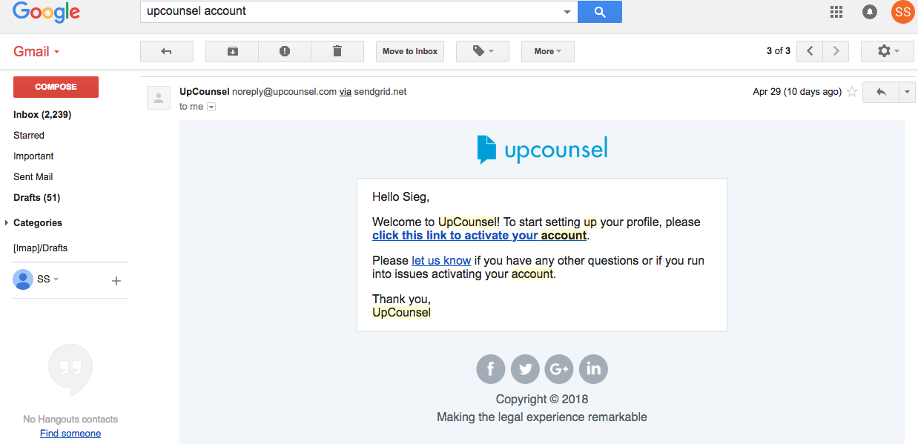
Medyo ganito
So our logo will be on top.

Slide 8
When the lawyers log in
There will be a news feed.
The news feed will have cases from:
The three specializations they selected
General Counsel
Retainer
Others

Slide 9
While logged in
Lawyers must be able to view their history and previous clients and works (with date of acceptance)
Lawyers must be able to view their previous offers
Lawyers must be able to view their profile

Slide 10
For Free Lawyers
They can see newsfeed.
Sa newsfeed, censored ang:
Full name of client
So kunwari Jayzon Alcancia
J.A. will appear
Email and Contact
So kunwari jaaaaa@gmail.com and 09171234567:
******@*****.com
0917*********
Jayzon, please devise a way na when they pay na, we can activate their account to full premium user experience.

Slide 11
List
So the list of lawyers will be alphabetical (last name)
Example:
Alcancia, Jayzon Jorge
Cusi, Martin, S.
Estilles, Ronald, Jr.
Suarez, Andre, S.
Suarez, Siegfrid, S.
Can be sorted by Luzon, Visayas, Mindanao

Slide 12
About
(Logo)
About Library For Lawyers List
Get a Lawyer
Post your job
Get proposals
Choose your lawyer

Slide 13
When you scroll down “About”
Disclaimer: We are not a law firm nor provide legal services. We are a platform that connects clients with lawyers in order to aid efficient administration of justice. We do not, in any way, advertise lawyers or their services. We provide accessibility to the law.

Slide 14
Labor
(Logo)
About Library For Lawyers List
Get a Lawyer
Employer
Employee
Contractor

Slide 15
Employer
(Logo)
About Library For Lawyers List
Get a Lawyer
List nalang ito. Wag na boxes.
(Selections)
Unfair Labor Practice by Employees
Employment Contract
Service Agreement for Legitimate Job Contracting
Handbook and Company Policies
Disciplinary Action
Others

Slide 16
Employee
List nalang ito. Wag na boxes.
(Selections)
Unfair Labor Practice by Employers
I was dismissed illegally

Slide 17
Always Second to the Last for All Options
I need:
Consultation
Full Legal Service
Retainer

Slide 18
Last Slide for ALL Options
Describe briefly your concern:
Write down any information about this engagement which you feel your lawyer needs to know before he can make an offer?
(Put a text box here, Jayzon and limit it to 500 characters)
(Put a text box here, Jayzon and limit it to 500 characters)

Slide 19
After the LAST SLIDE
Client Information
First Name:
Middle Name:
Last Name:
Organization:
Mobile No.
Email:
Jayzon, for all clients which submit, let’s make a database
Of information for our benefit.
Thank you.

Slide 20
Post a job
Contracts and Agreements
Start a Business
Labor
Annulment/Separation
Accidents
Sale (I am the Buyer) (I am the Seller)
Tax
Criminal
Land Titles
General Counsel
Collection
Yung up to “General Counsel”,
Naka box yan. 10 items yan.
Yung nasa baba, list nalang.
Ibig sabihin ng “Sale (Real
Property) (Personal Prop..)” is
That once you put the cursor
On top of “Sale”, lalabas yung
“Real Property” or “Personal.”
This is the same sa Intellectual
Property, and sa Family.
Intellectual Property (trademark) (patent) (copyright)
Banking and Finance
Immigration
Family (Adoption) (Child Custody) (Child Support)
Others
Basic Forms

Slide 21
(Logo)
About Library For Lawyers List
Get a Lawyer
Here is how “post a job” will look like:
(Picture of Contracts)
Contracts
And Agreements
Start a Business
Basic Forms (Special Power of Attorney/Secretary’s Certificate etc.)
Corporate Retainer
Intellectual Property Banking and Finance Immigration
Wills Family Others
(Adoption/Child Custody/Child Support)

Slide 22
Annulment/Separation
I want to file annulment/separation from my spouse
My spouse filed an annulment/separation from me
Others

Slide 23
Annulment Separation (next question)
You are:
Filipino Citizen
Foreigner
Dual (including Filipino)
Your spouse is:
Filipino Citizen
Foreigner
Dual (including Filipino)

Slide 24
Accidents
I am the victim
I caused the accident

Slide 25
Sale
I am the Seller
I am the Buyer

Slide 26
Sale (next slide for both)
Real Property
Personal Property

Slide 27
Real Property
House
Lot
House and Lot
Condominium Unit
Building
Others

Slide 28
Personal Property
(This will now go to the last slide) (yung may write down your concern in 500 words briefly)

Slide 29
Tax
I need assistance in payment of taxes
I need tax avoidance schemes
I sold a property or shares of stock and I need assistance in the filing of taxes
I need assistance in tax matters on setting up a company
BIR has sent me a notice
Others

Slide 30
I need assistance in payment of taxes
On time and regular
Delayed or with issues

Slide 31
Criminal
I am the victim
I am the accused

Slide 32
Criminal (next slide)
Bouncing Check
Estafa
Murder/Homicide/Physical Injuries
Rape
Carnapping
Theft/Robbery
Trespassing
Graft and Corruption/Bribery
Others

Slide 33
Land Titles
( last slide na agad)

Slide 34
General Counsel
(last slide agad)

Slide 35
Corporate Retainers
(Logo)
About Library For Lawyers List
Get a Lawyer
Stock Corporation
Non-Stock Corporation/Foundation
NO NEED for the SECOND TO THE LAST SLIDE for this category

Slide 36
Stock Corporation
(Logo)
About Library For Lawyers List
Get a Lawyer
Micro Business (Assets of P3M and below)
Small Business (Assets of over P3M up toP15M)
Medium Business (Assets of over P15M up to P100M)
Large Business (Assets of over P100M and above)

Slide 37
Non-Stock Corporation
(Logo)
About Library For Lawyers List
Get a Lawyer
Condominium Corporation
Homeowner/Village Association
Foundation
Other

Slide 38
Library
Philippine Constitution
Revised Penal Code
Family Code

